Slide 1
Horizontal Axis Wind Turbine

Slide 2
Working Principle
The horizontal-axis wind turbine (HAWT) is a wind turbine in which the main rotor shaft is pointed in the direction of the wind to extract power

Slide 3
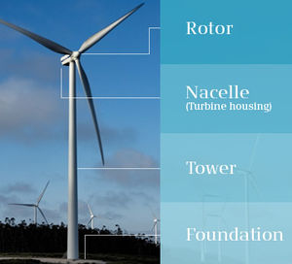
Parts of a Horizontal Axis Wind Turbine
Foundation:
Tower
A tower that supports the nacelle and rotor hub at its top. These are made from steel and concrete,. Height of the tower is an important Because wind speed increases with height.
Nacelle
A housing which contains all the components essential for operating the turbine. It is fitted at the top of a tower and includes the gear box, shafts, generator, controller, and brakes. A wind speed anemometer and a wind vane are mounted on the nacelle.

Slide 4
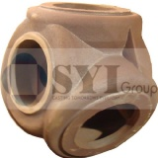
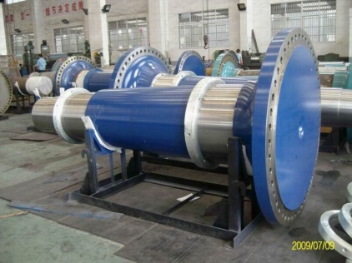
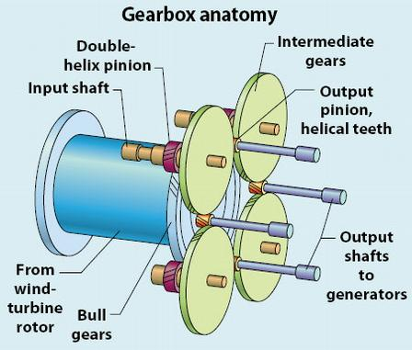
Construction
Hub A rotor hub is provided for coupling a wind turbine rotor blade and a shaft. The hub assembly consists of hub, bolts, blade bearings, pitch system and internals . Hub is made of steel.
The types of rotor hubs are
Hinge-less hub
Teetering hub
Drive shaft Drive shafts are used to transfer rotational
mechanical energy from blade hub to the generator to produce electricity. A wind turbine normally consists two shafts .
Main shaft: called as 'low speed shaft'.
Generator: shaft 'high speed shaft'.
Gear box It changes low speed high toque power coming from a rotor blade to high speed low torque power which is used for generator. It is connected in between main shaft and generator shaft. Gearboxes used for wind turbine are made from superior quality aluminum alloys, stainless steel, cast iron etc.
The various gear boxes used in wind turbines are
Planetary Gearbox
Helical Gearbox
Worm Gearbox

Slide 5
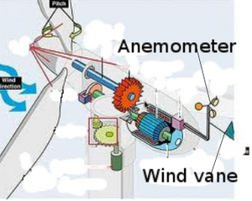
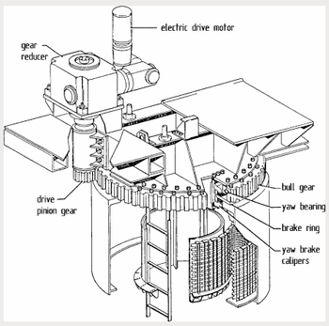
Construction
Generator
The gear box is connected to the generator through generator shaft. It works on the principle of 'Faraday's law of electromagnetic induction and converts mechanical energy into electrical energy.
Anemometers
This device which is used for measuring wind speed of wind. This is usually located on top of the nacelle.
Wind vane These are used to measure the wind directions and communicates with the yaw system to orient the turbine properly with respective to wind directions.
Yaw Mechanism
yaw mechanism turns the rotor into the upwind direction as the wind direction changes. Electric motors and gear boxes are used to keep the turbine yawed against wind. This can be also used as controlling mechanism during high wind speeds.

Slide 6
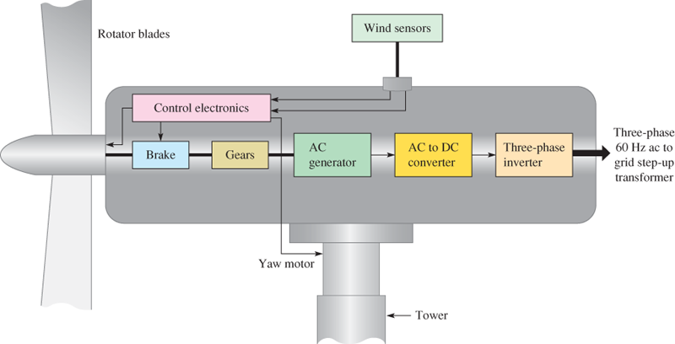
Working
The rotor receives energy from the wind and produces a torque on a low-speed shaft. The low-speed shaft transfers the energy to a gearbox, high-speed shaft, and generator, which are enclosed in the nacelle for protection.
The blades are connected to the rotor and to the shaft. In low-speed shaft wind turns the rotating assembly at a 10 to 20 revolutions per minute (rpm) typically.

Slide 7
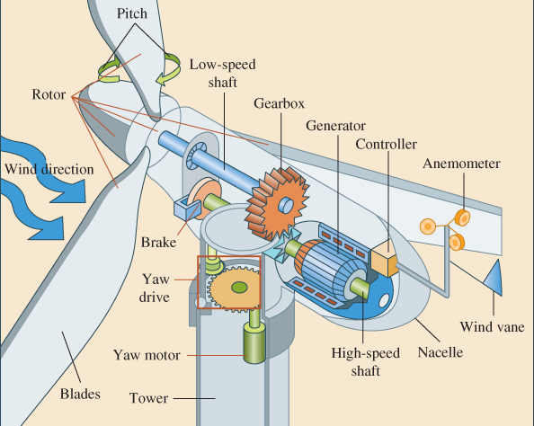
Applications
Horizontal axis wind turbines achieve better power output & higher energy efficiency. They are used in large-scale wind power plants and electricity generation.
In industrial plants
large-scale wind farms

